Slide 1
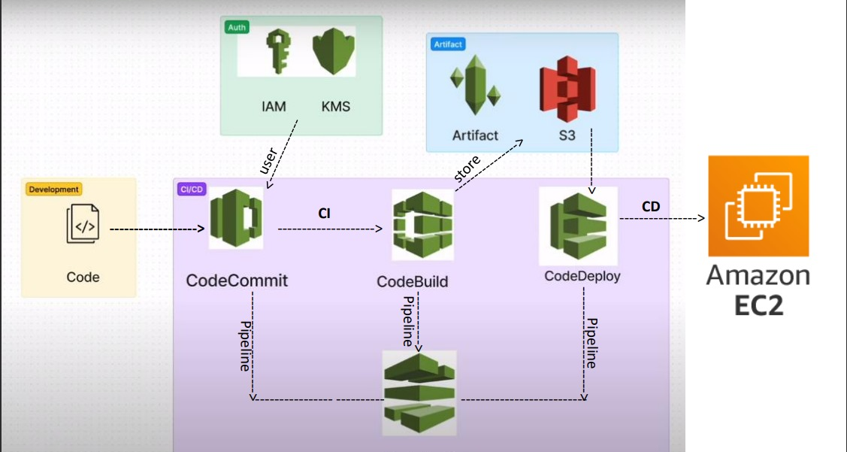

Slide 2
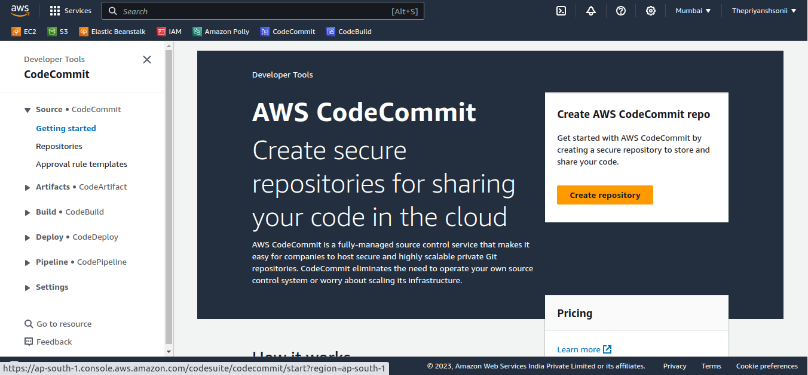
Go to AWS CodeCommit:
Select Create repository.

Slide 3
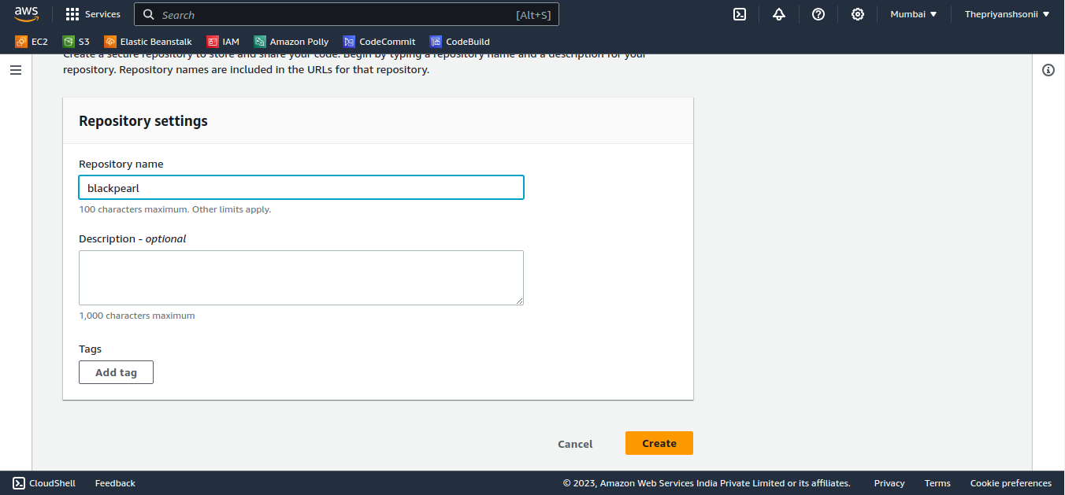
Repository Setting:
Provide a Repository name and click on create.

Slide 4
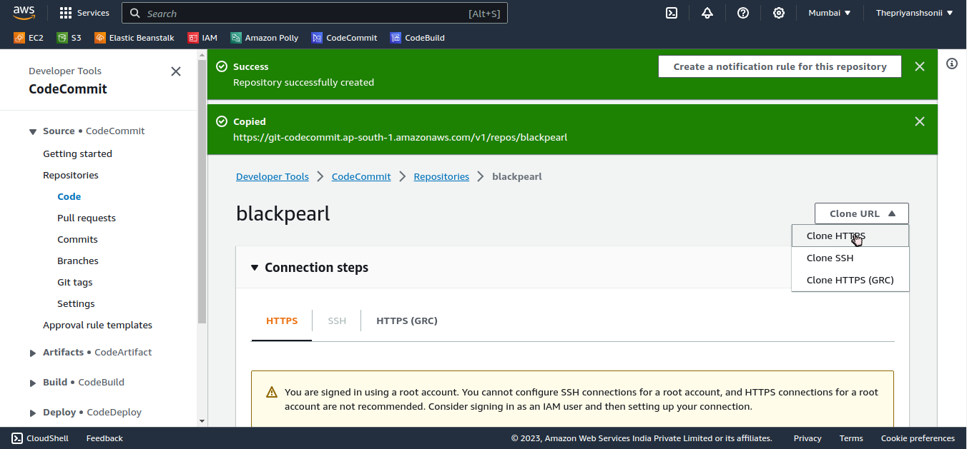
Repository is Created:
Your repository is created click on clone url and select on “clone HTTPS” and copy the link.

Slide 5
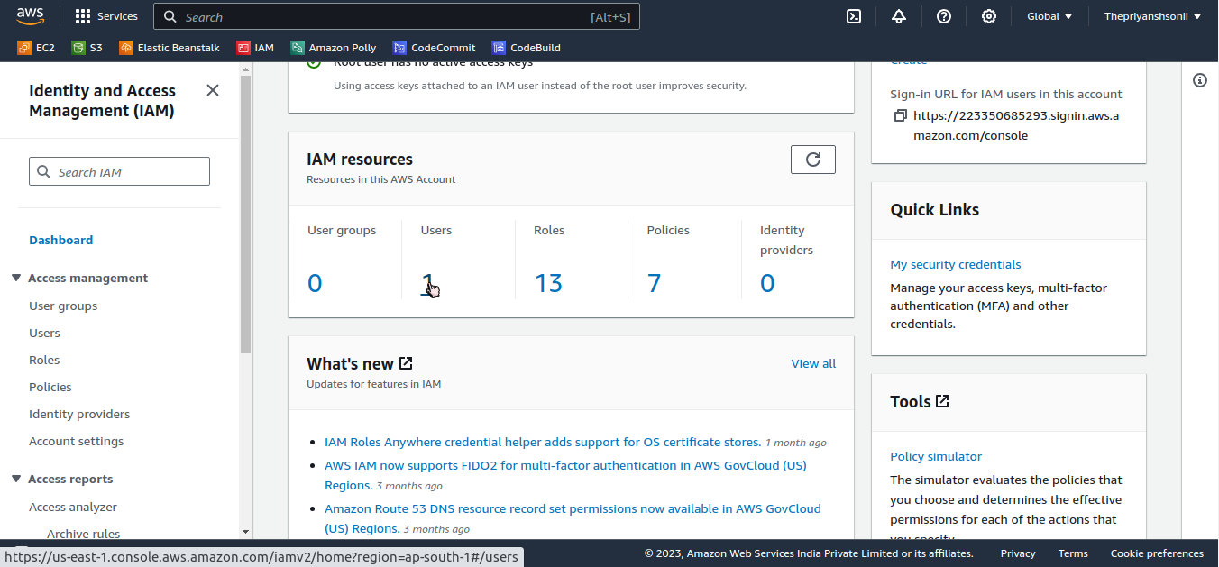
Creating IAM User:
This user is created to provide credentials to your CodeCommit.

Slide 6
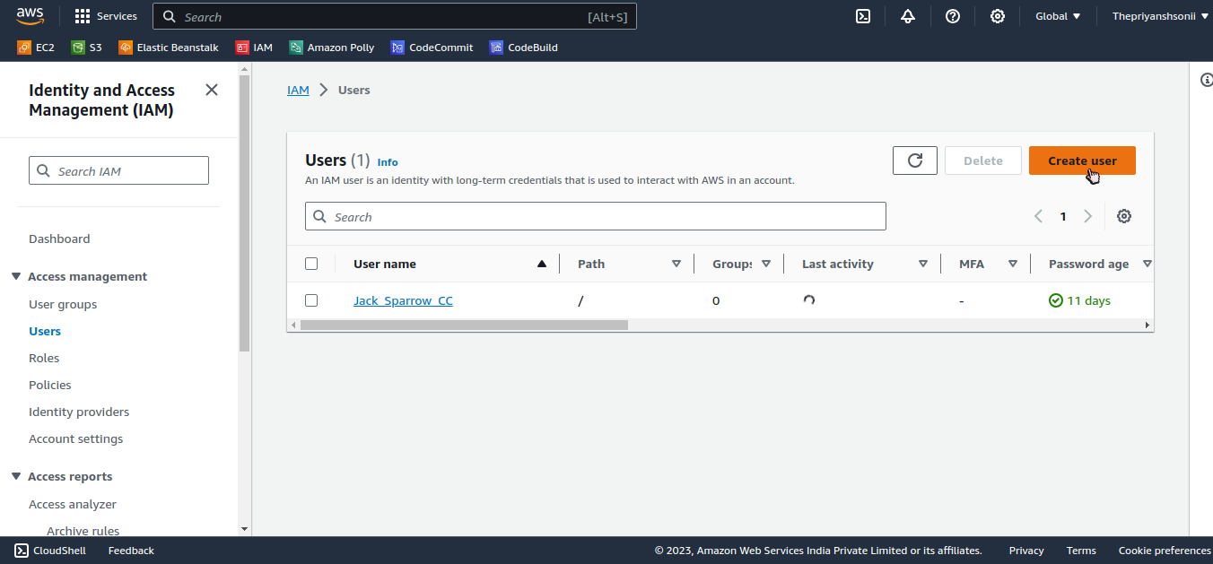
Create User:

Slide 7
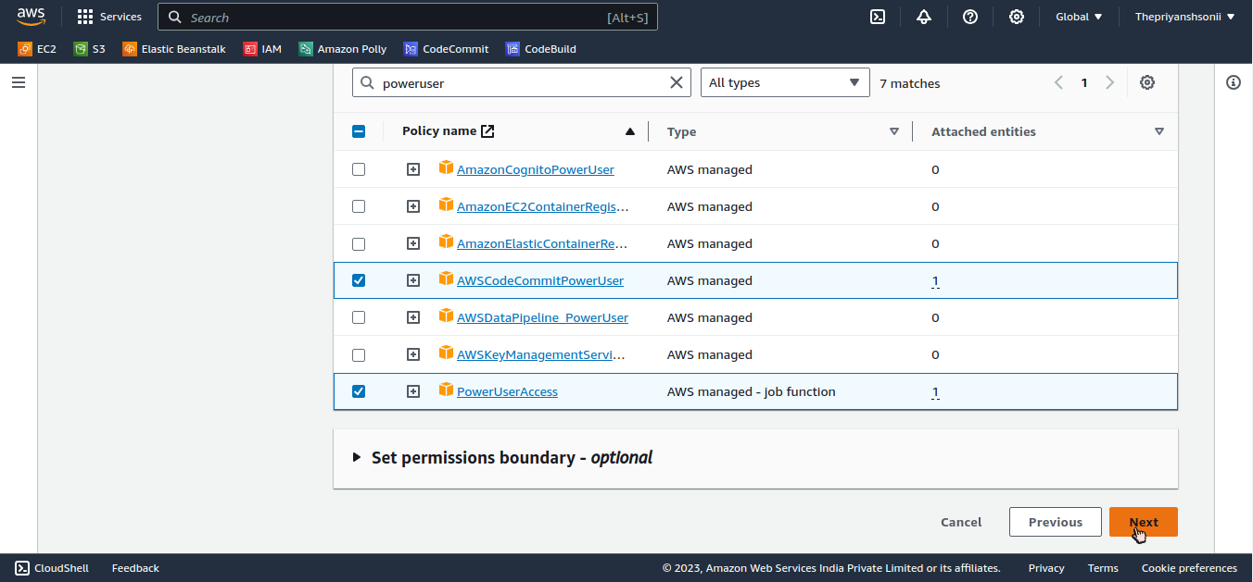
Attach Policies:
Providing the policy to use.

Slide 8
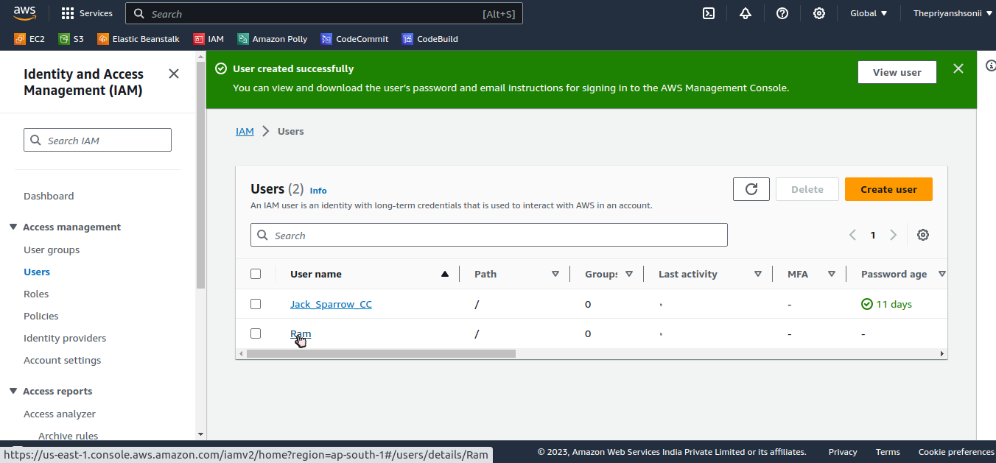
IAM user is created:
Click on username.

Slide 9
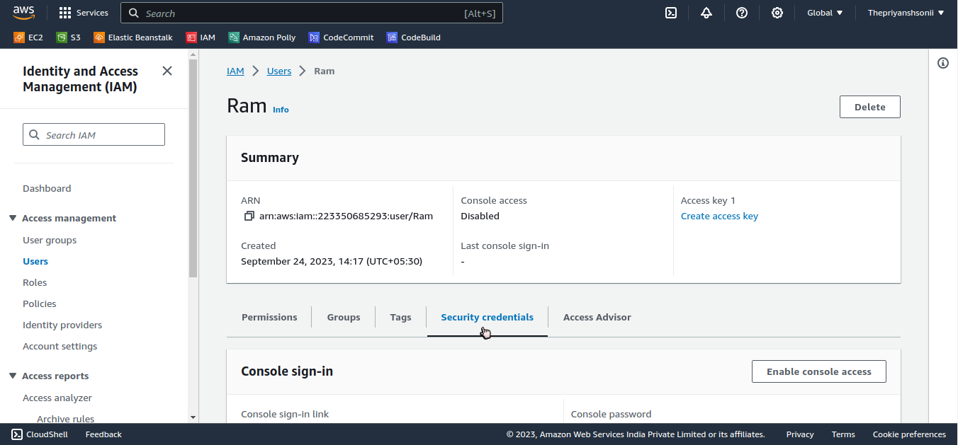
Security Credentials:
Here you get your CodeCommit id and password.

Slide 10
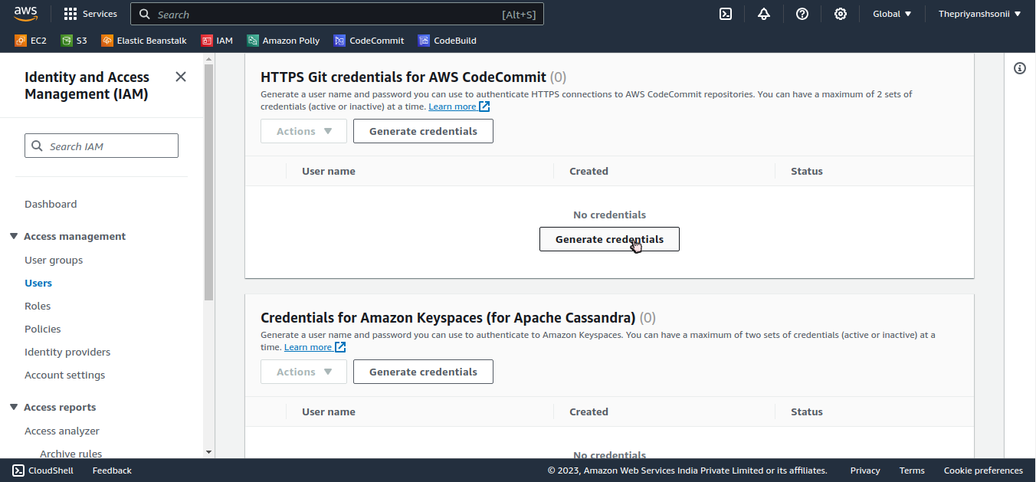
HTTPS Git Credentials:
Click on Generate Credentials.

Slide 11
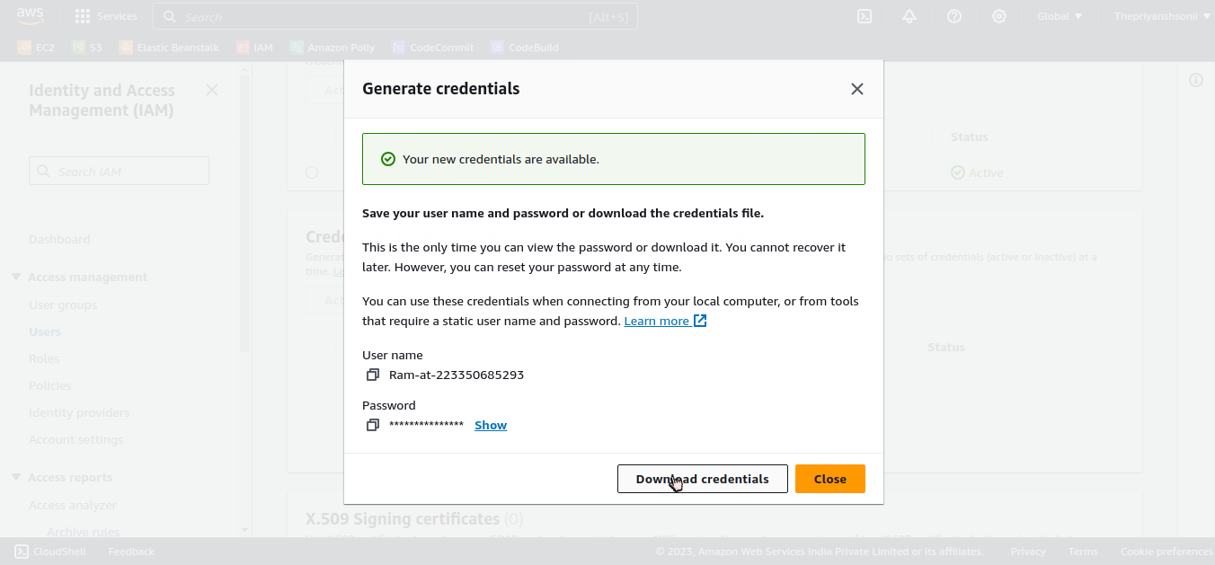
Git Credentials:
Downloads Credentials to access CodeCommit.

Slide 12
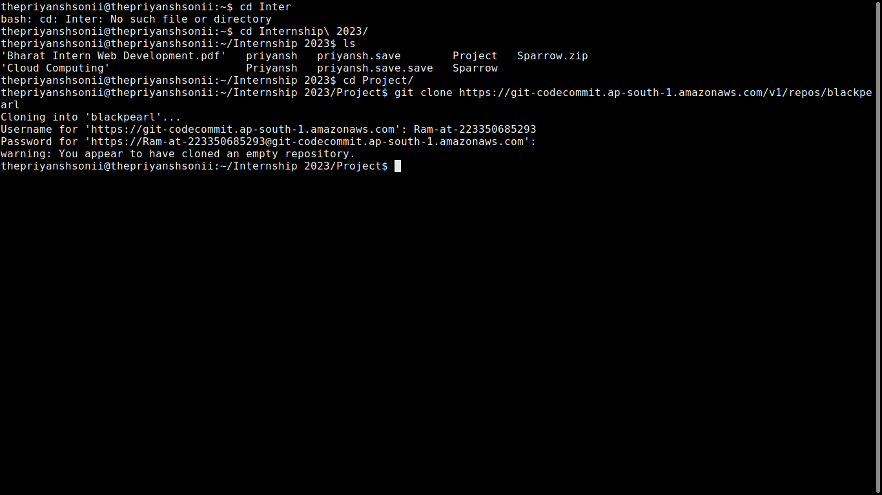
Linux Terminal/Windows CMD/Git bash
Clone your CodeCommit repository.

Slide 13
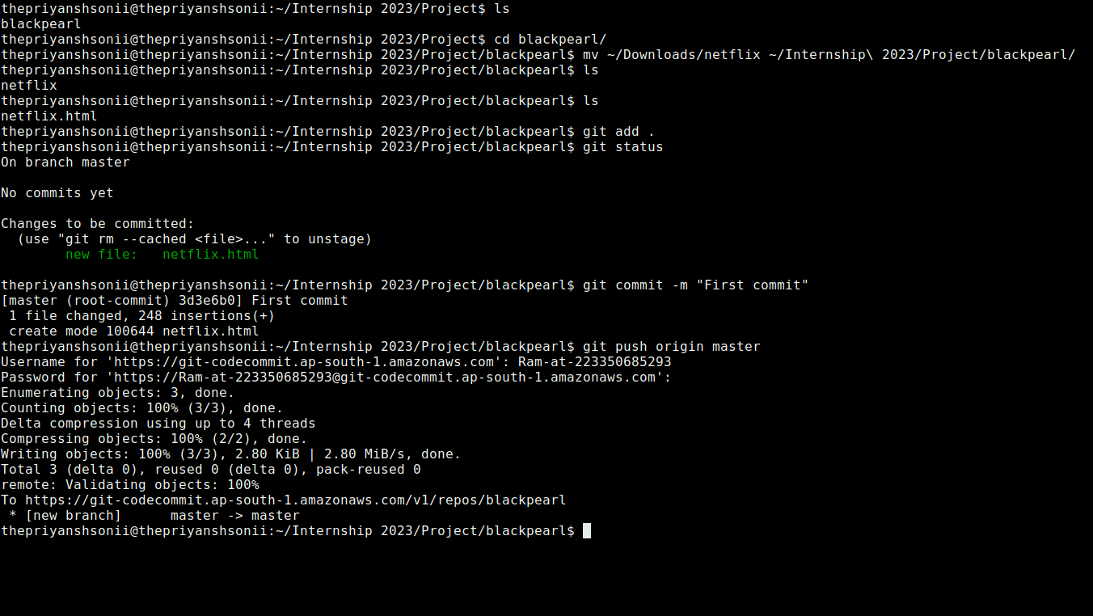
Repository is Cloned:
Your Repository is cloned using that url paste your forntend code here named as “index.html” and push it to CodeCommit using Git Credentials.

Slide 14
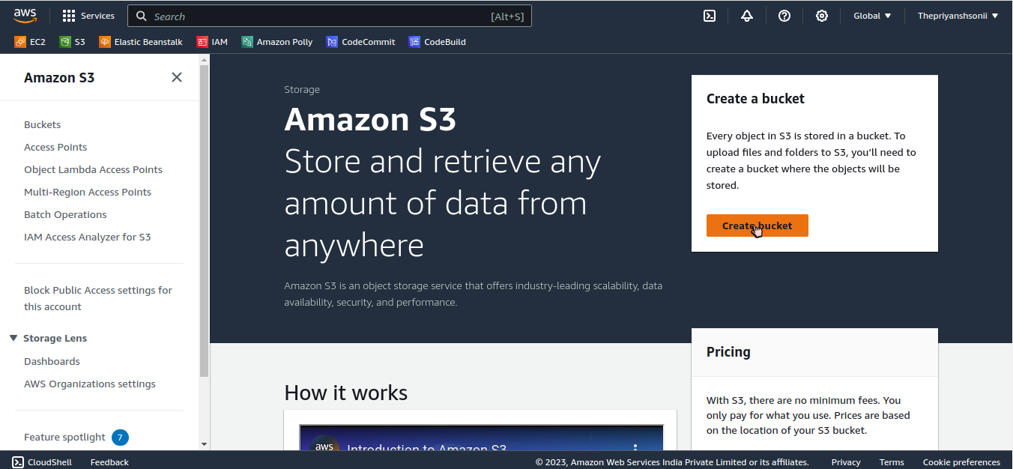
Amazon S3 Bucket:
Create Bucket.

Slide 15
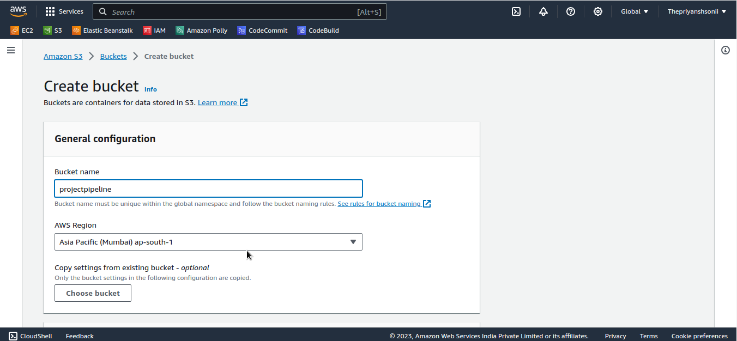
Creating Bucket:

Slide 16
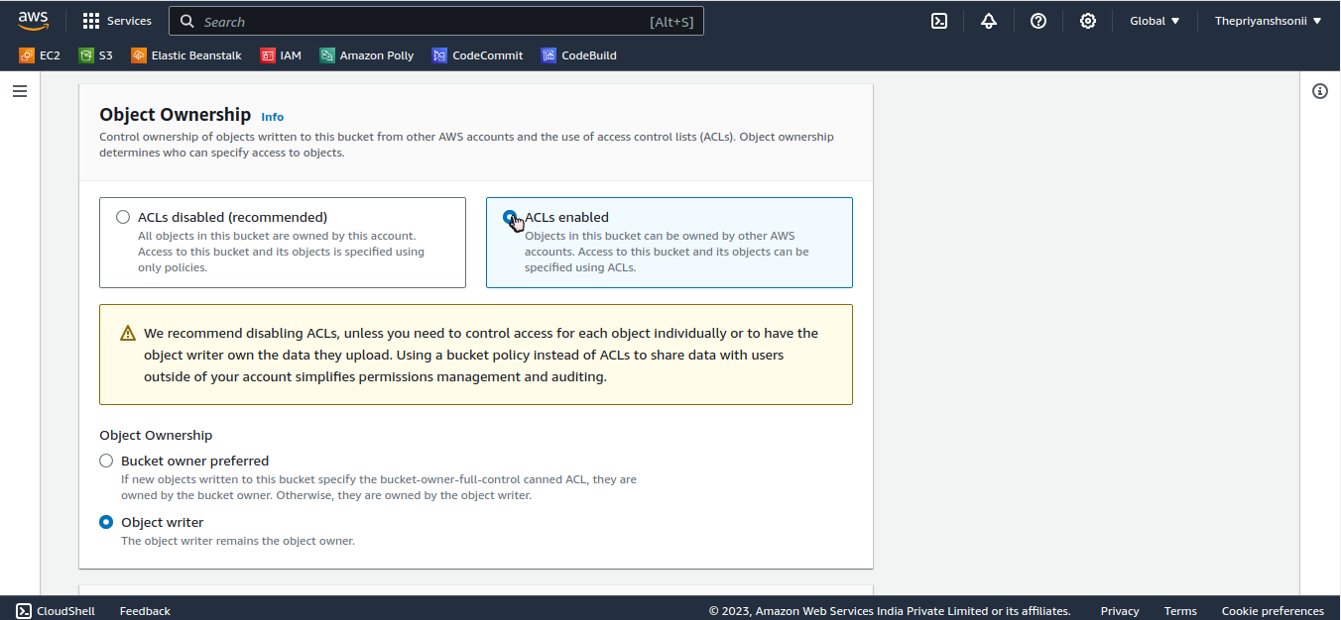
Creating Bucket:

Slide 17
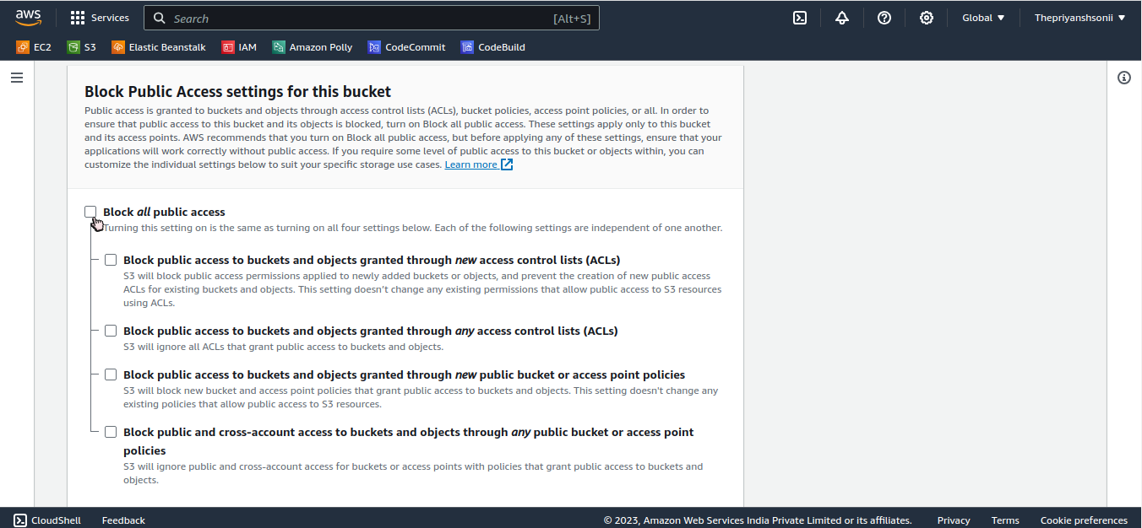
Block all public access in Bucket:

Slide 18
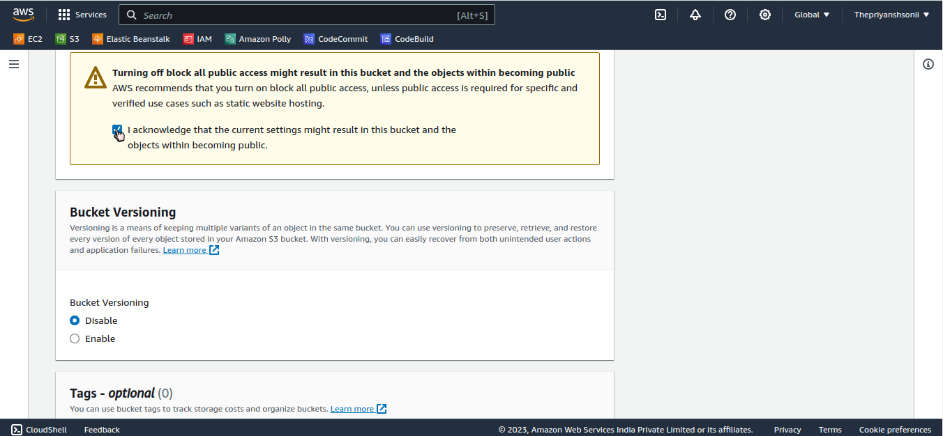
Making S3 Bucket public:

Slide 19
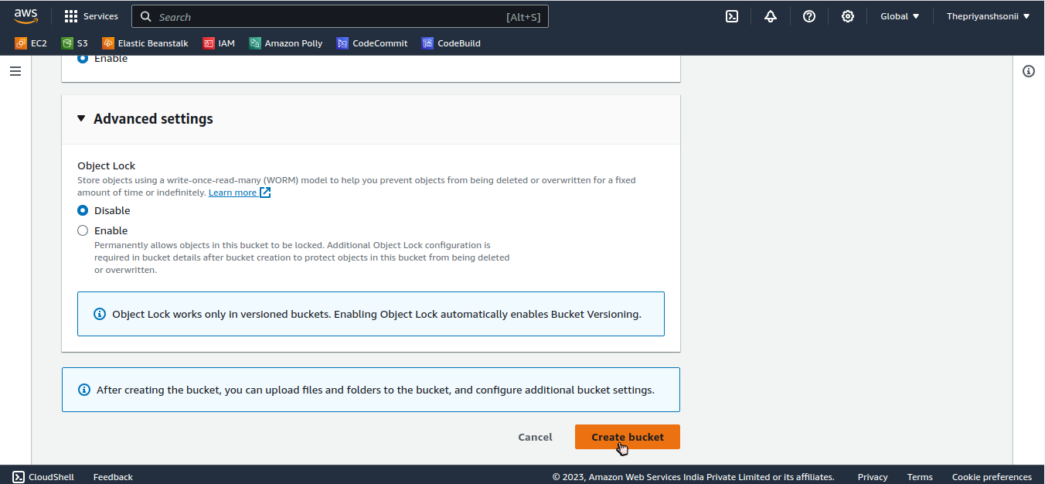
Create Bucket:

Slide 20
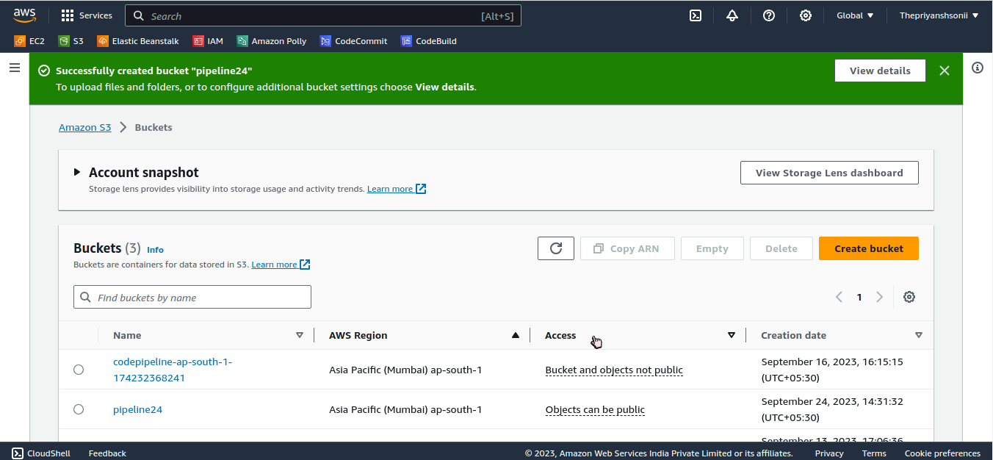
S3 Bucket Created:

Slide 21
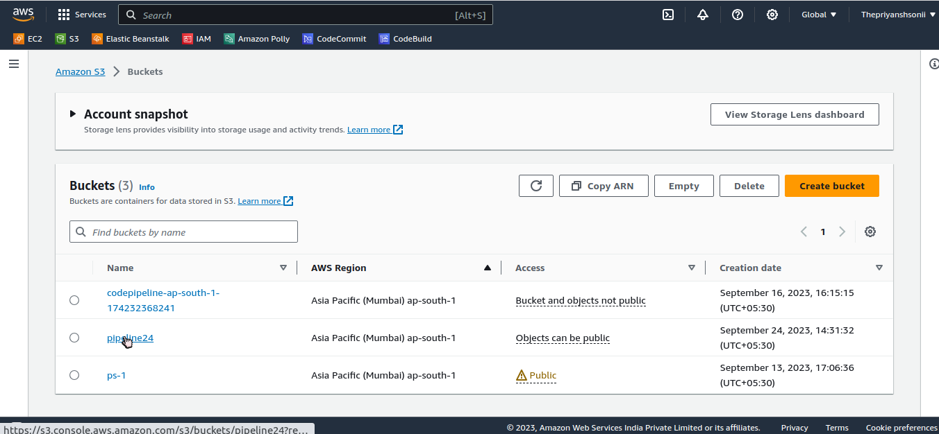
Amazon S3 Bucket:
Click on your Bucket name.

Slide 22
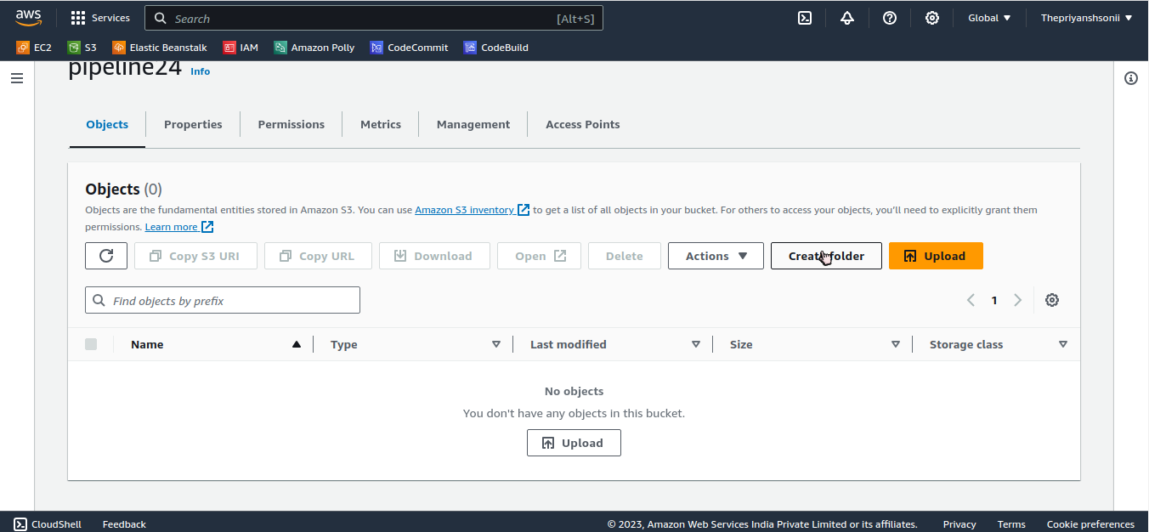
Create Folder:
Click on create folder.

Slide 23
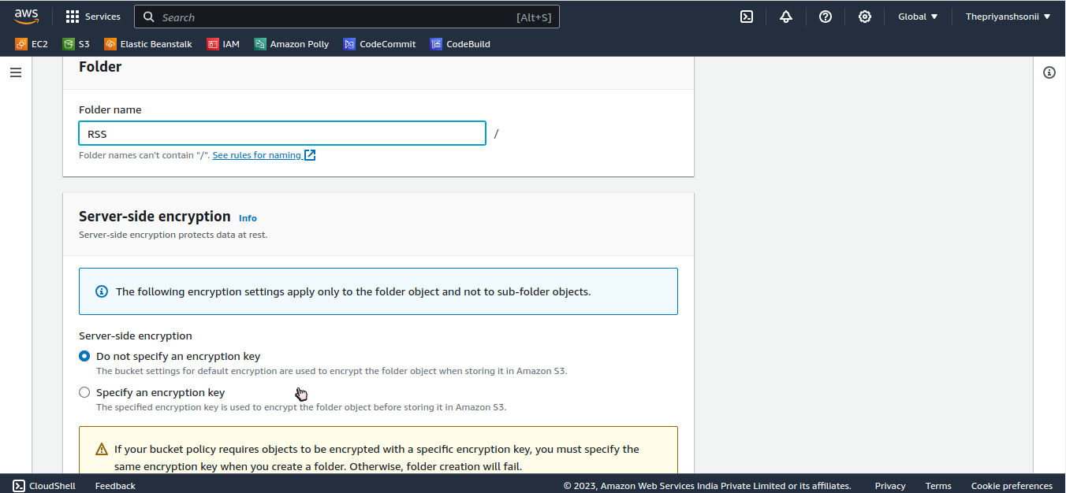
Bucket Folder:

Slide 24
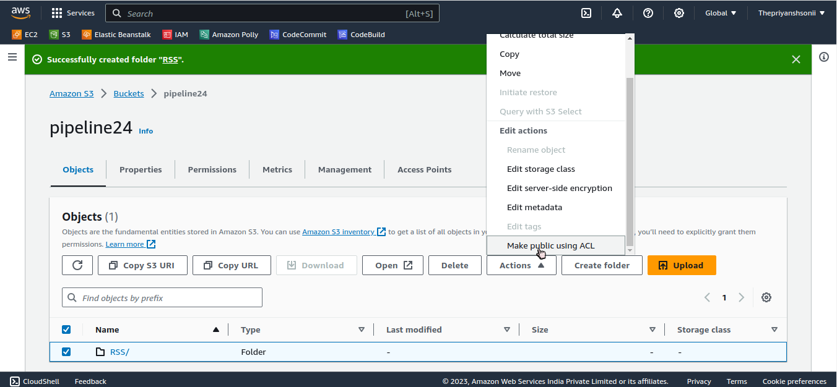
Make folder Public:
Click on action then select make public using ACL.

Slide 25
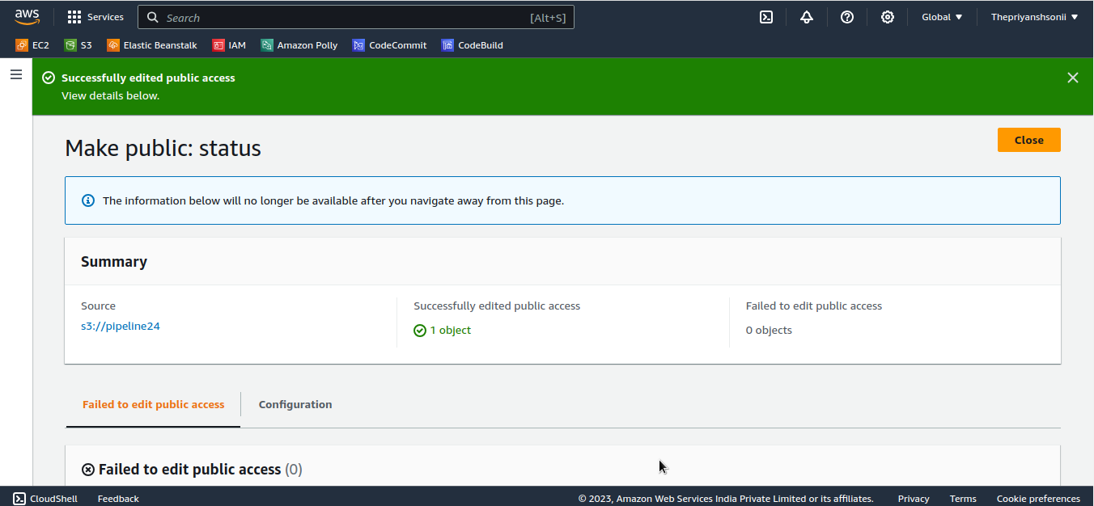
Bucket folder is public now:
Successfully edited public access.

Slide 26
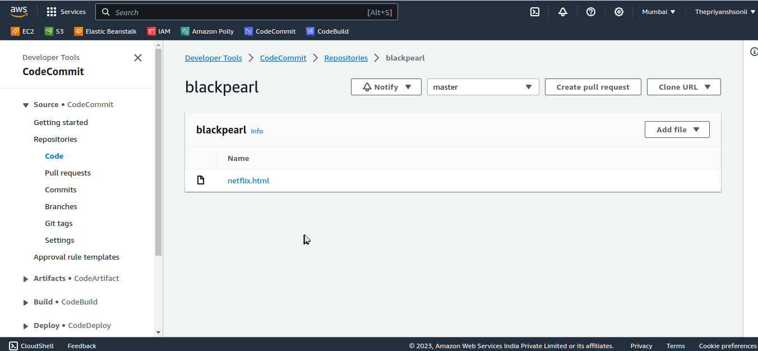
CodeCommit:
Now click on your repository name , your file is push here.

Slide 27
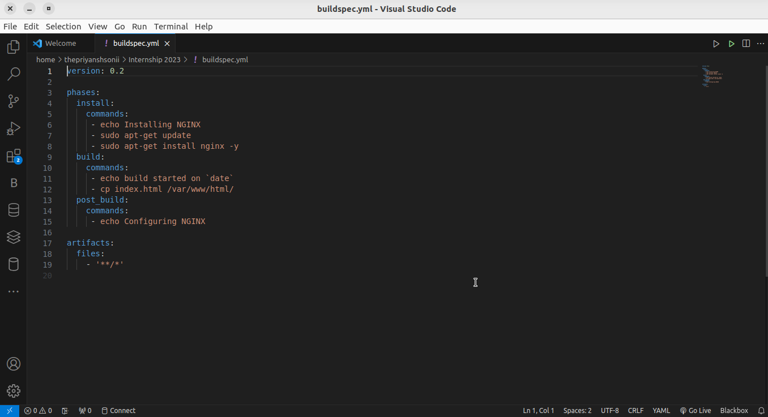
Create a buildspec.yml file:

Slide 28
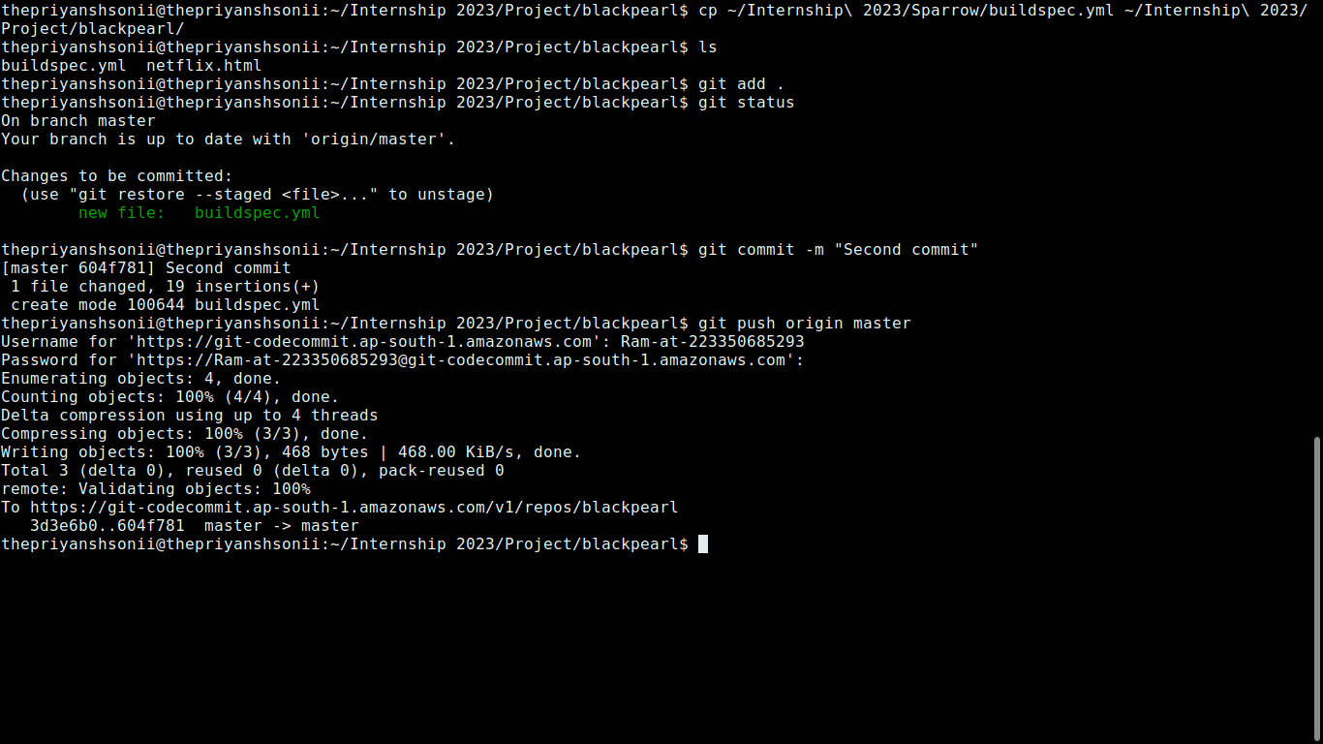
Push buildspec.yml file:
Move your buildspec.yml file to your repository directory/folder in your local host and then push it to CodeCommit.

Slide 29
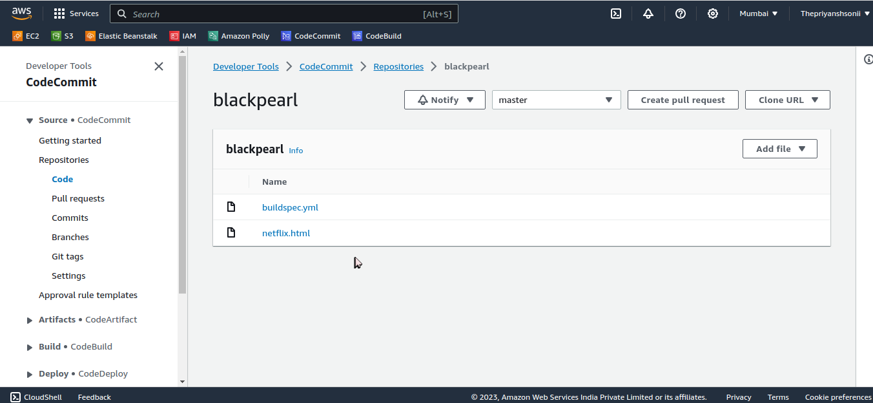
Buildspec.yml in CodeCommit:
Go to your CodeCommit repository and got their the builspec.yml file.

Slide 30
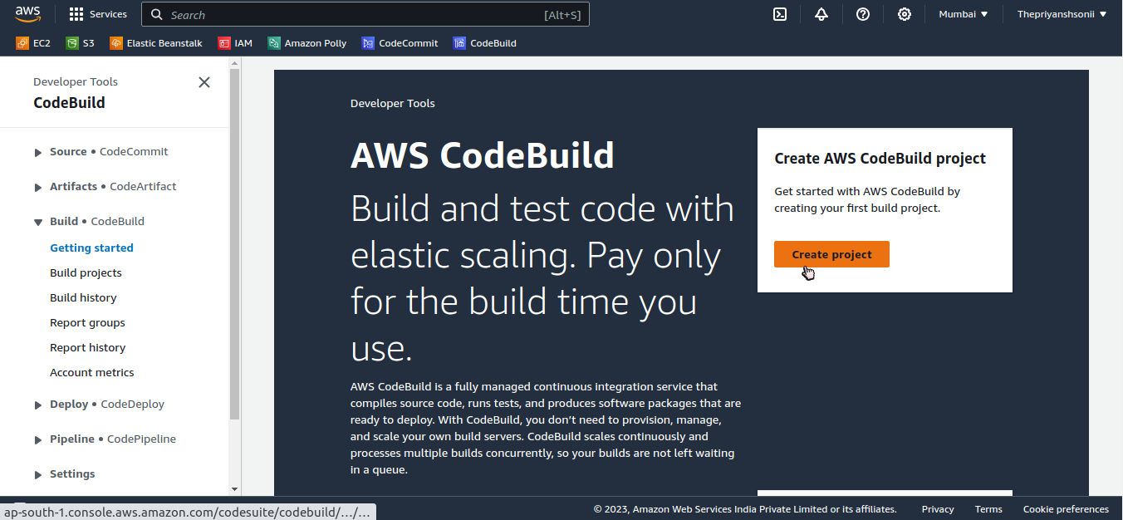
AWS CodeBuild:
Click on Create project.

Slide 31
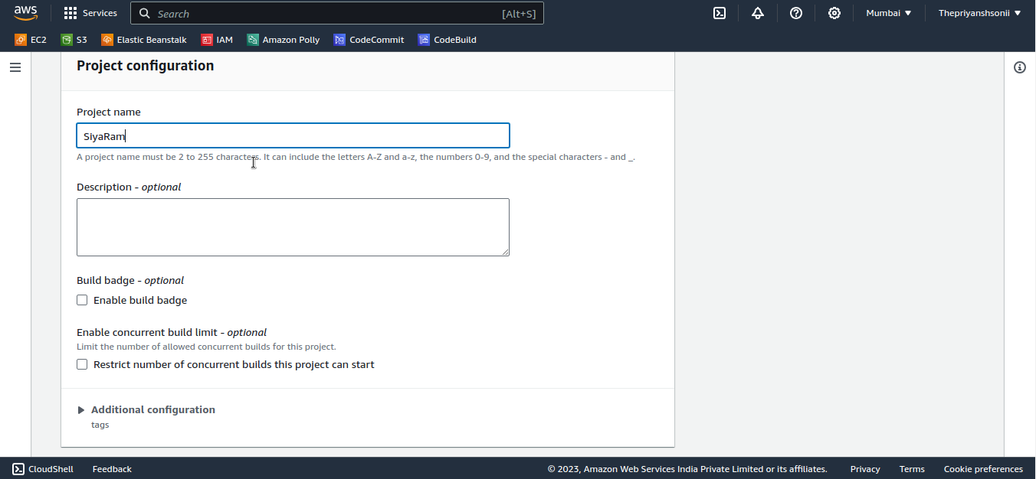
Set project configuration:

Slide 32
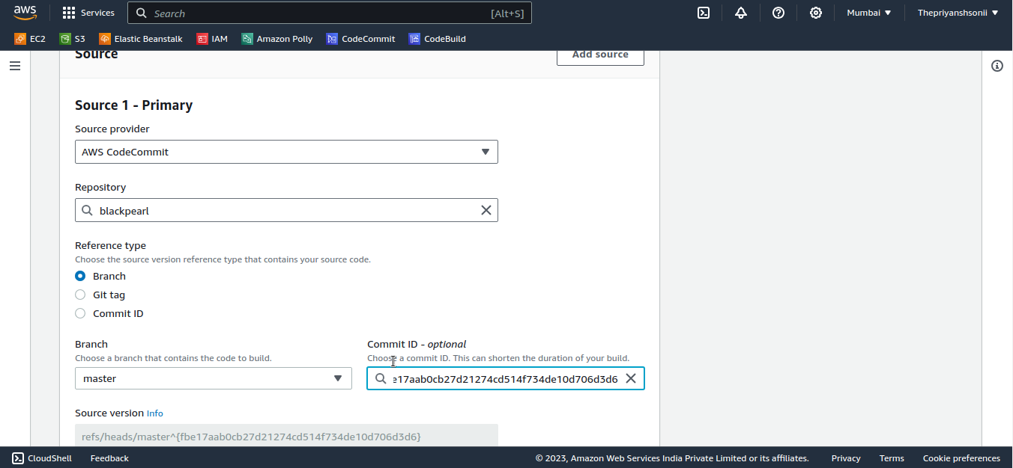
AWS CodeBuild:

Slide 33
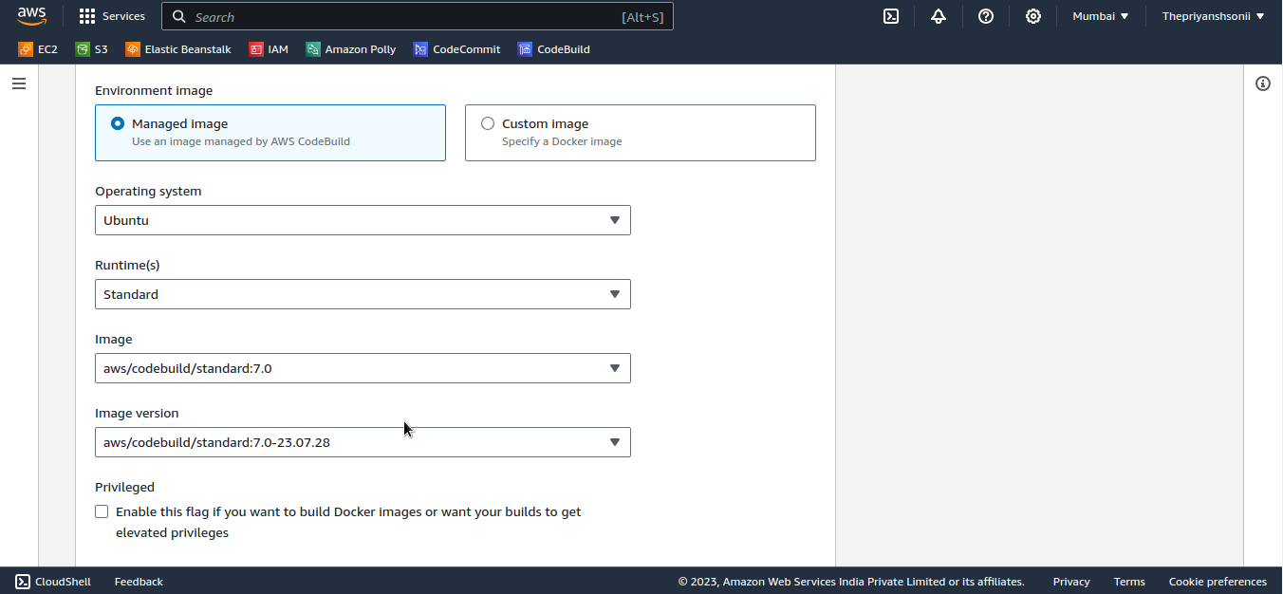
Configure Enviornment:

Slide 34
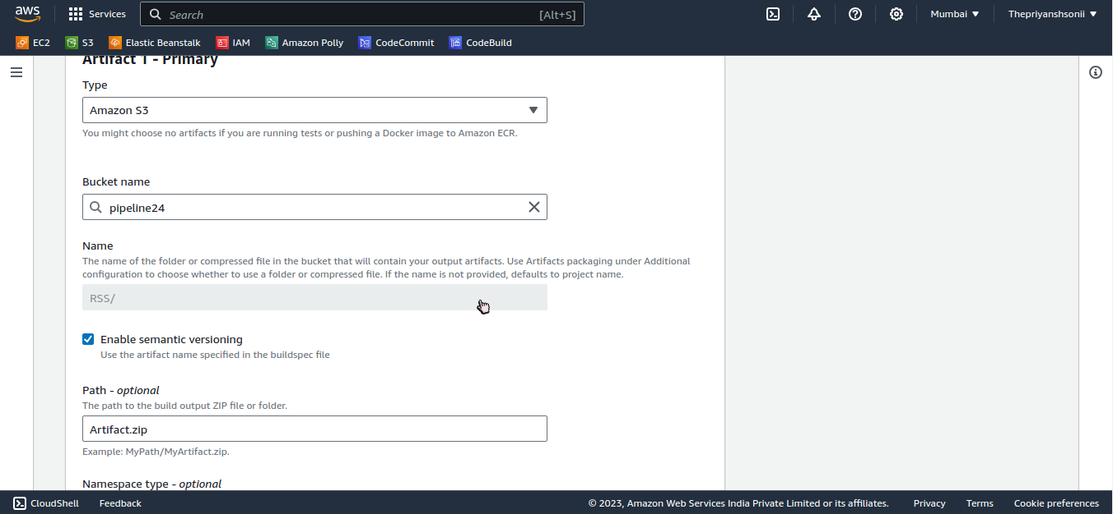
Provide Amazon S3 details:
In the name section paste your S3 Folder name.

Slide 35
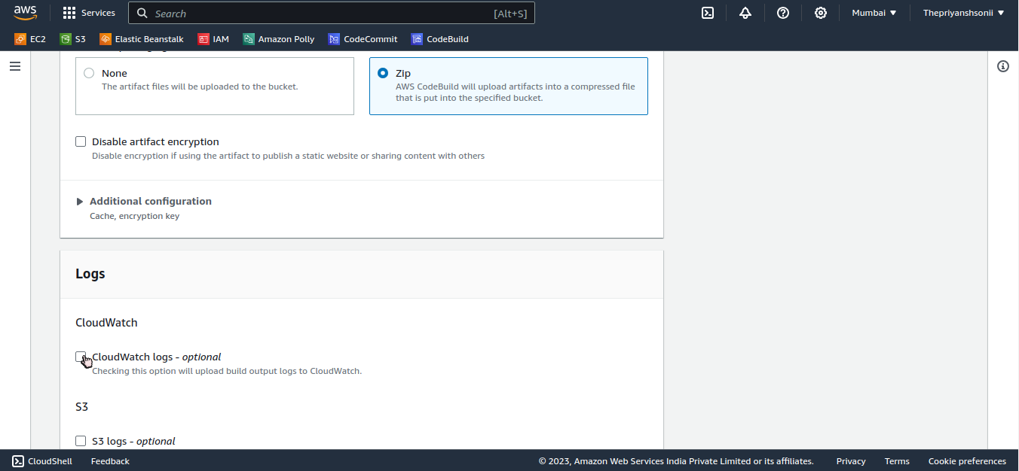
CodeBuild:
Disable the CloudWatch.

Slide 36
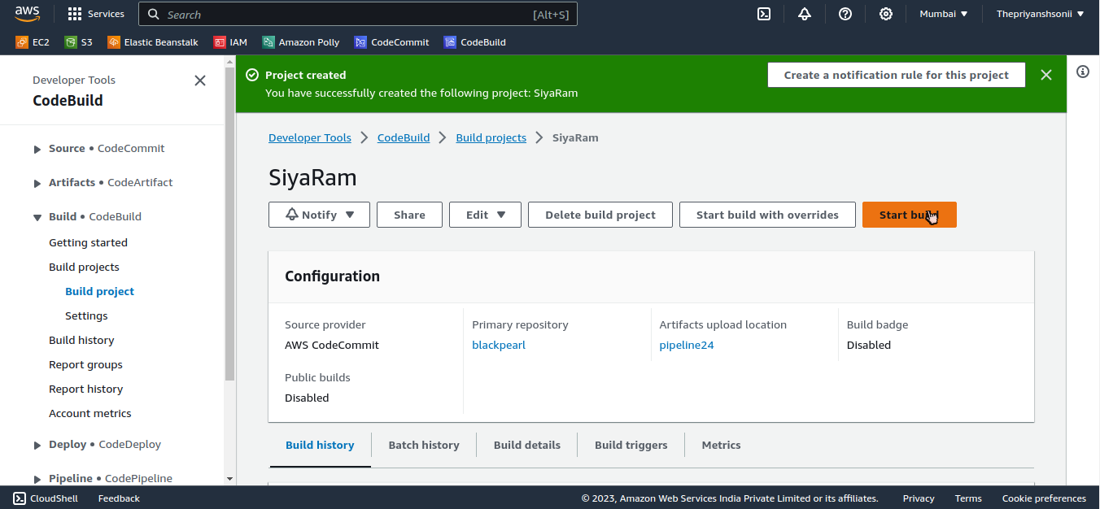
Project Created:
Click on Start build.

Slide 37
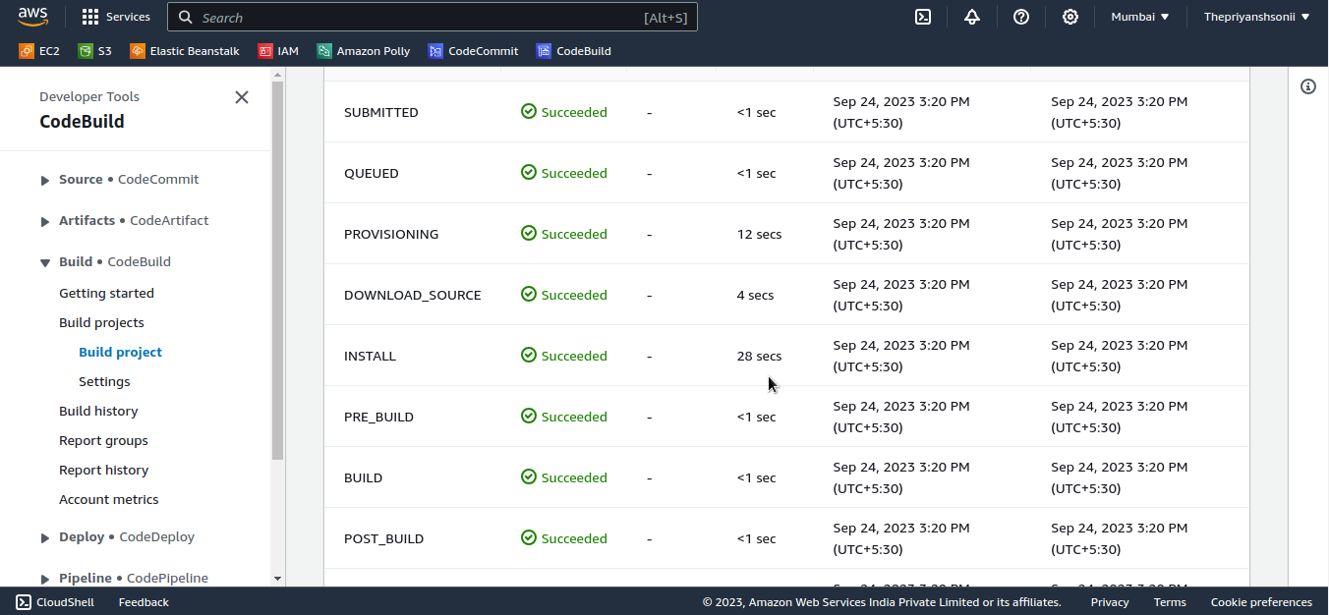
Go to Phase Details:
Wait until all processes are Succeeded.

Slide 38
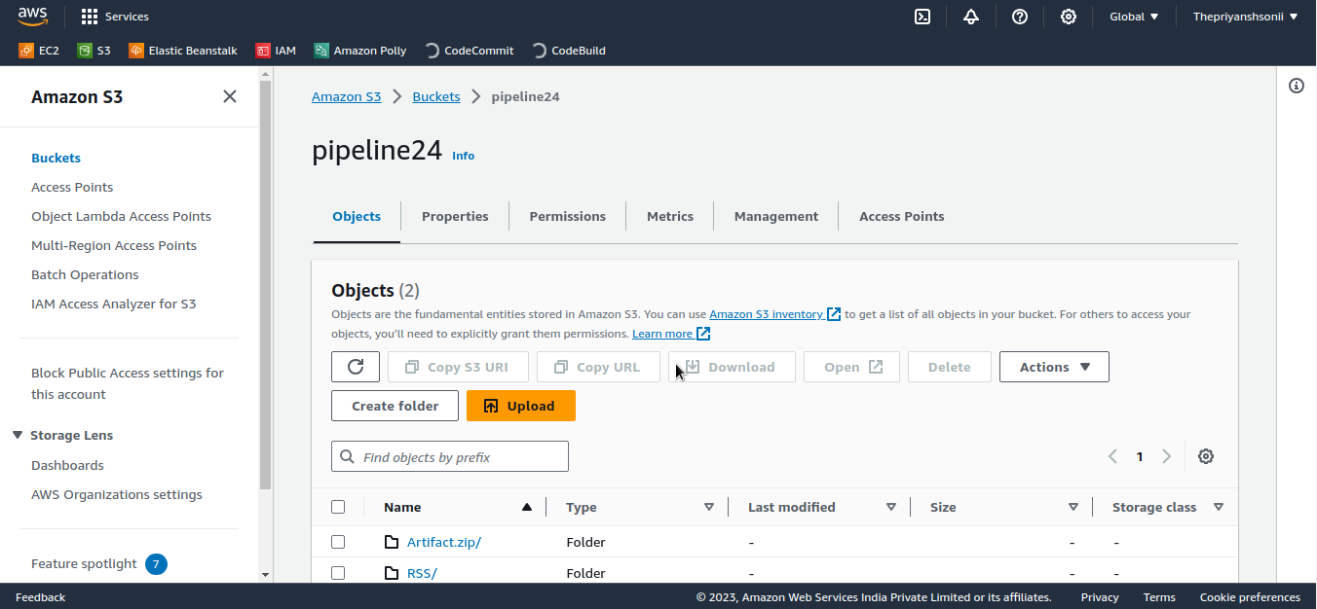
S3 Bucket:
Now you got new file “Artifact.zip” in your S3 bucket with your folder.

Slide 39
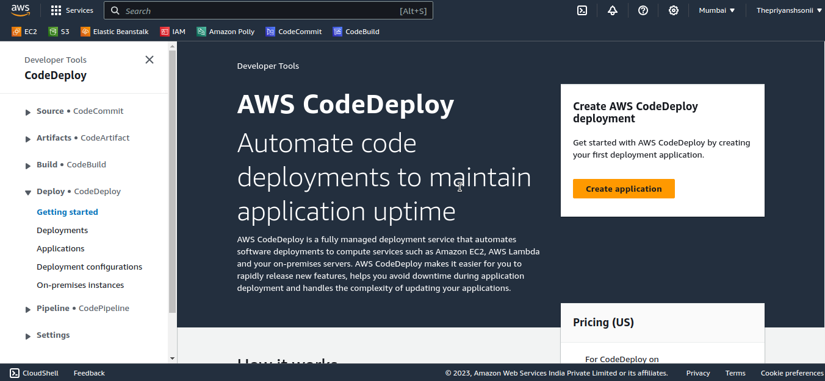
AWS CodeDeploy:
Click on Create application.

Slide 40
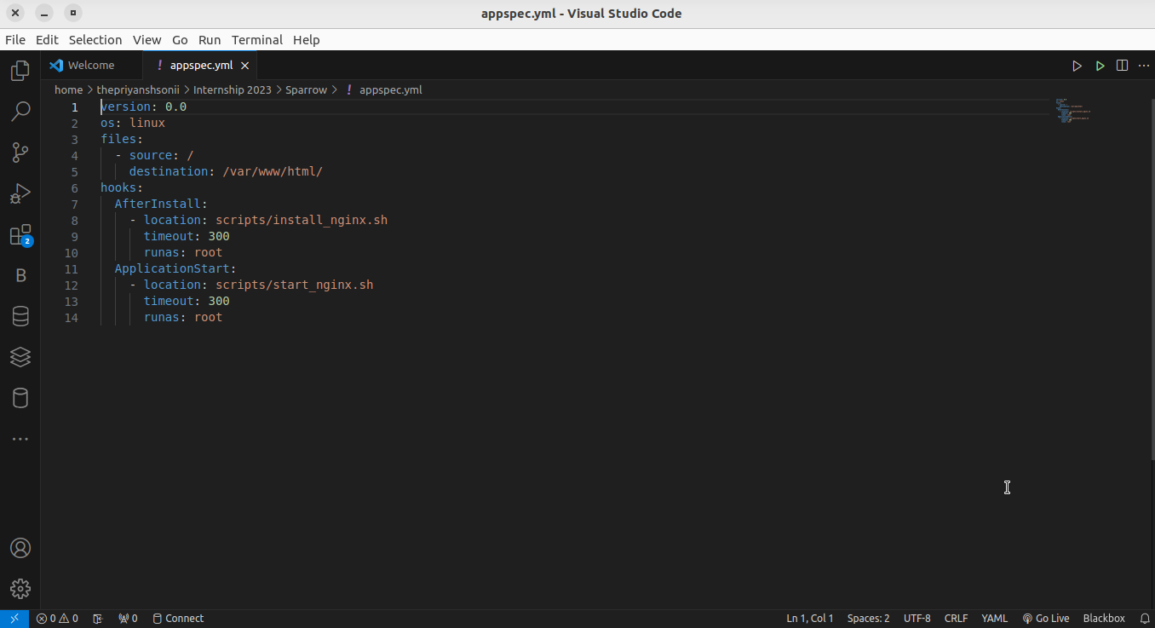
Create a appspec.yml file:

Slide 41
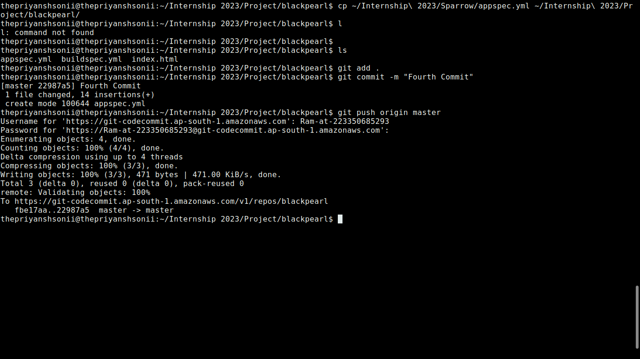
Push appspec.yml file:
First you should to move appspec.yml file to your repository directory/folder in your local host then push it into CodeCommit.

Slide 42
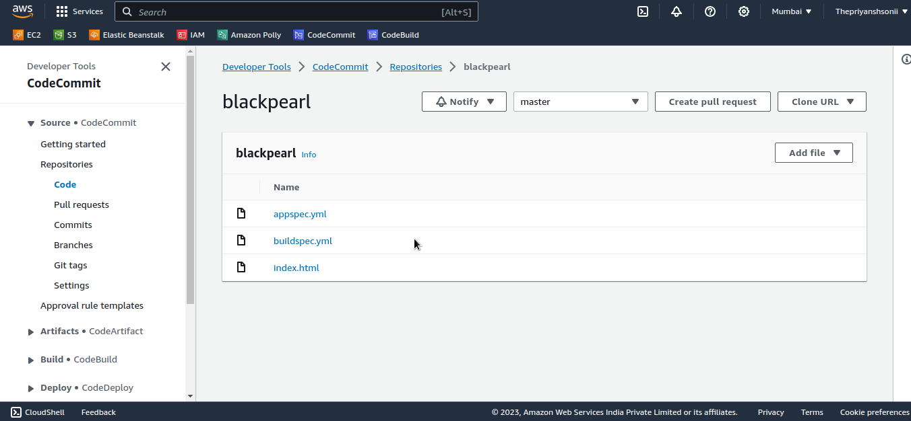
CodeCommit:
Now you got your all files in your repository also.

Slide 43
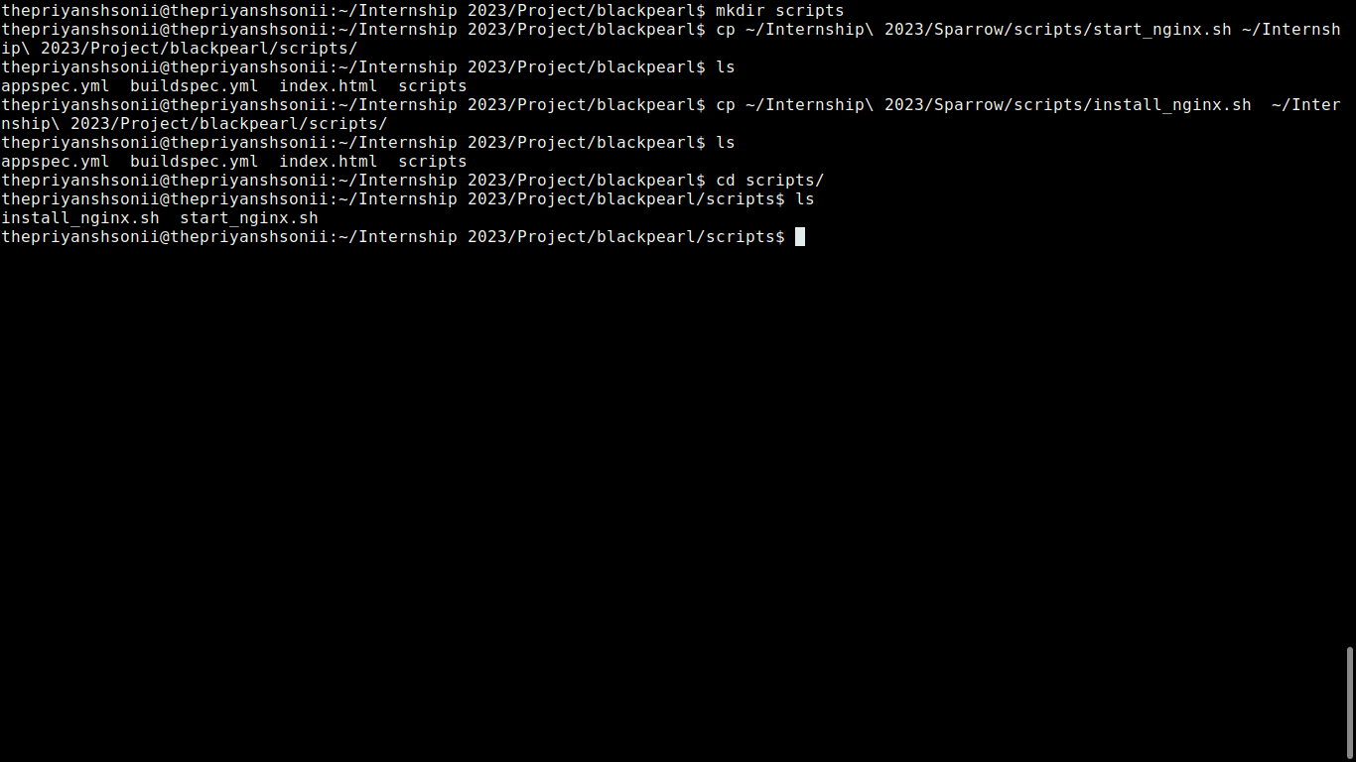
Make scripts folder:
Make a script director/folder in your local host in which you should to insert the start_nginx.sh and install_nginx.sh files.

Slide 44
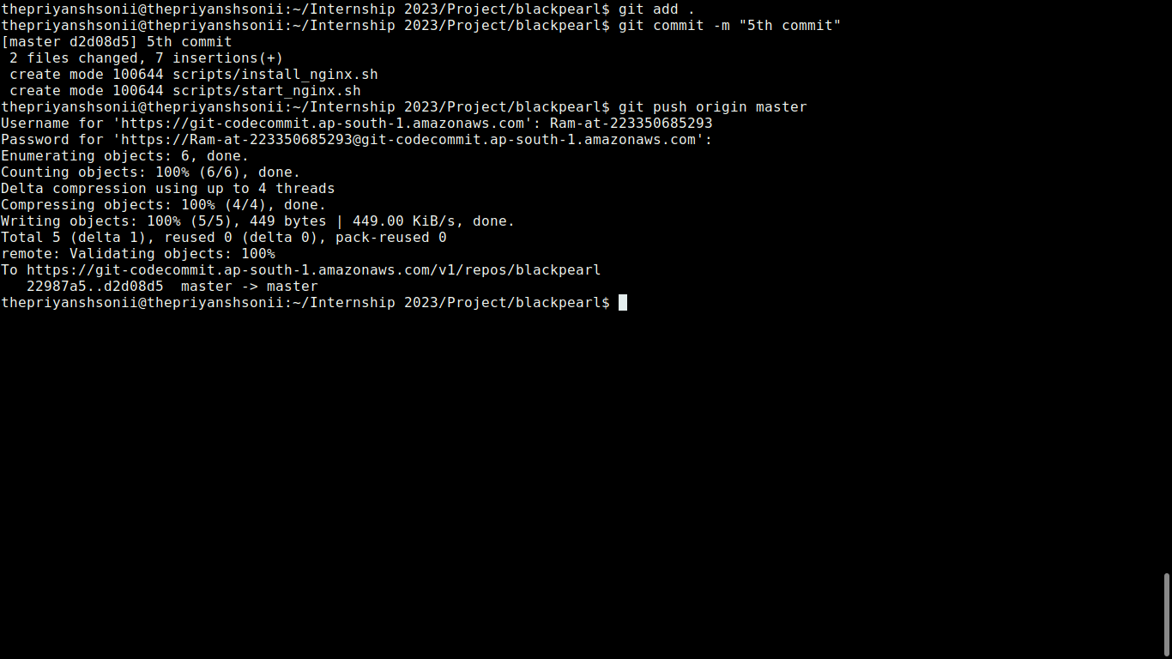
Push scripts to CodeCommit:
Linux users face username and password authentication paste them through Git credentials file from your downloads.

Slide 45
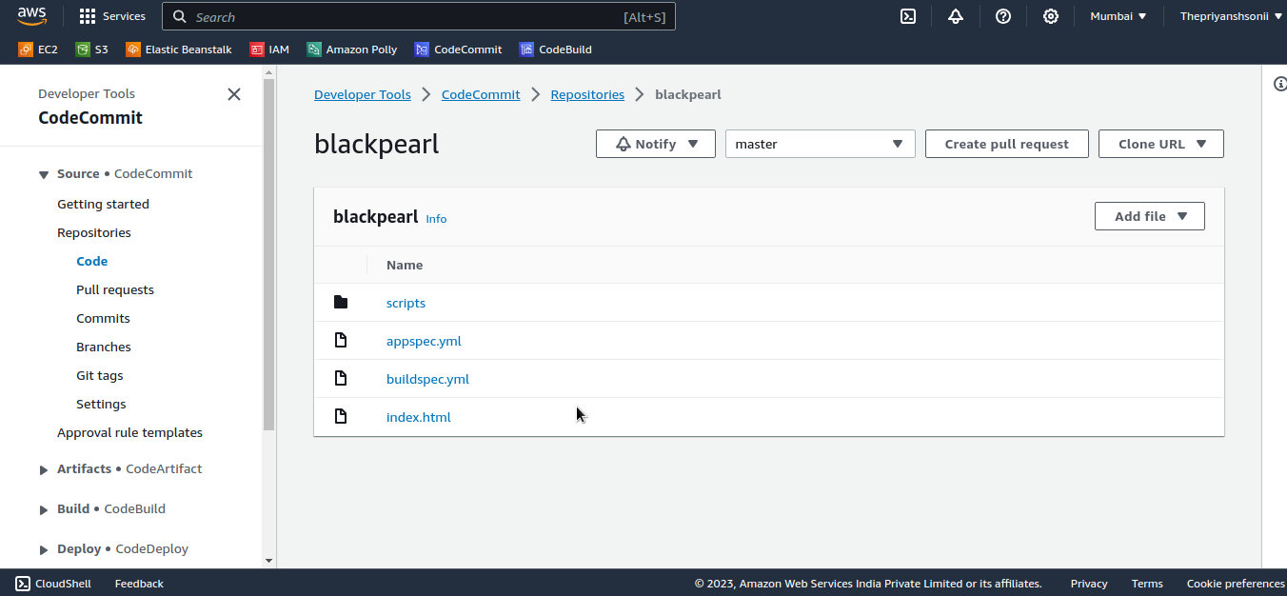
CodeCommit:
Now again you got your all files here.

Slide 46
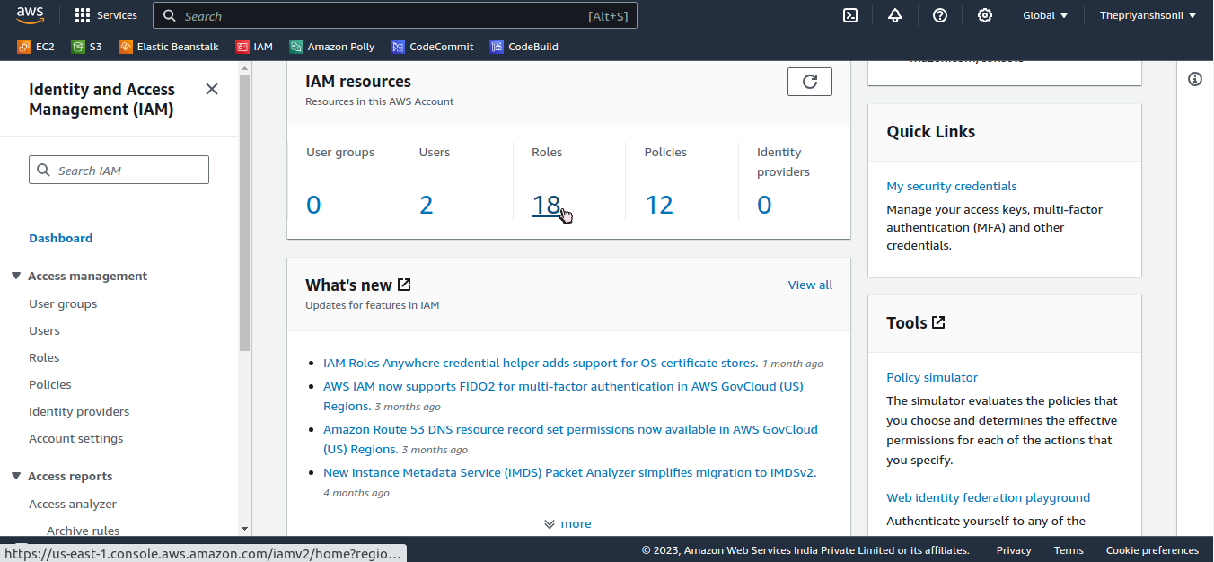
IAM Role:
Now click on roles.

Slide 47
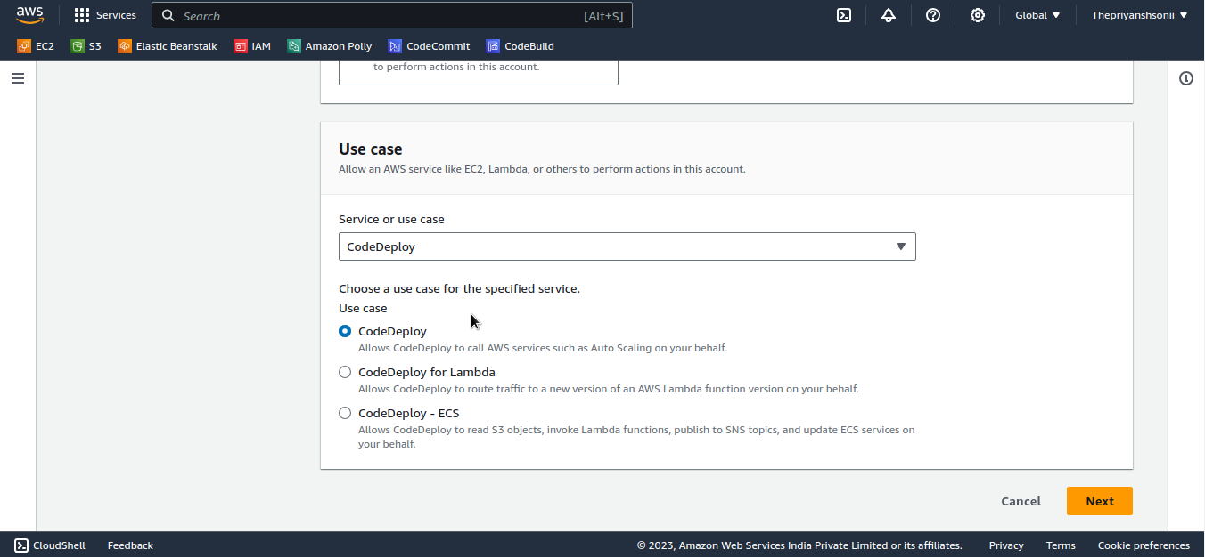
Creating IAM role for CodeDeploy:

Slide 48
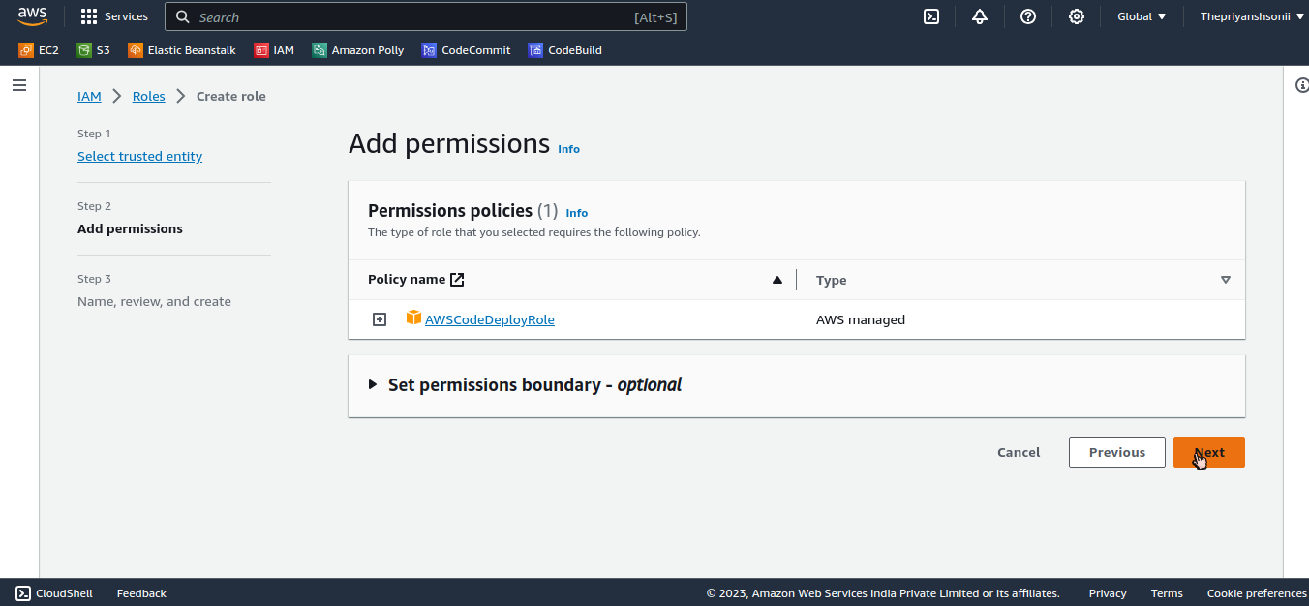
IAM Role....

Slide 49
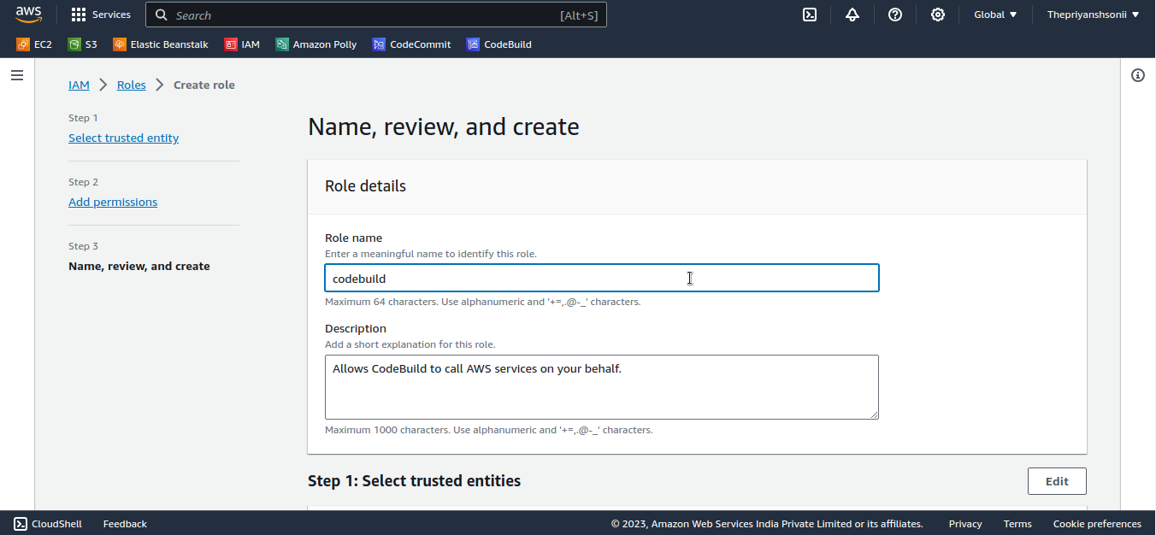
Providing Details:

Slide 50
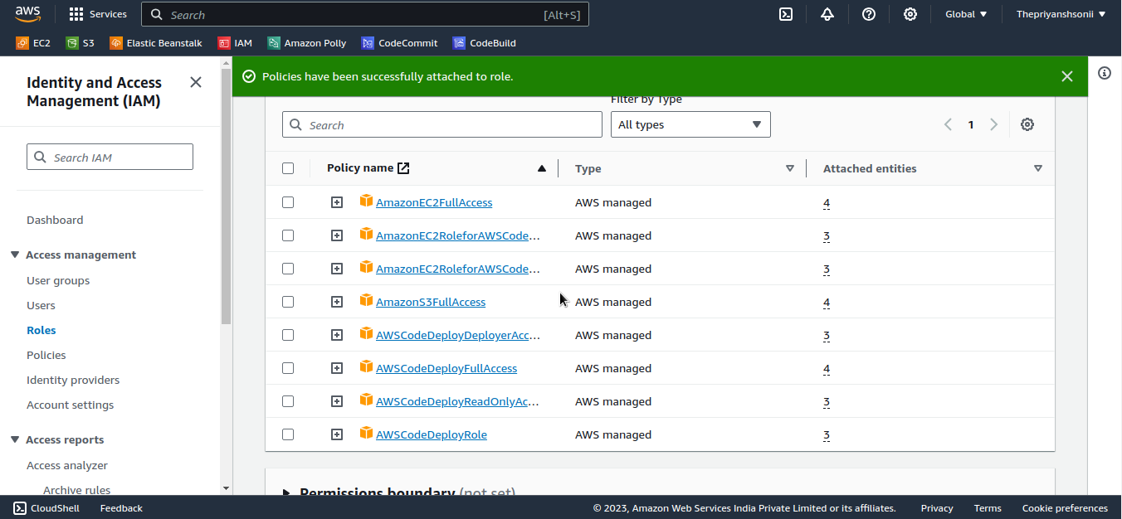
IAM Role Created:

Slide 51

Create a “.zip” file:
Create a “.zip” file of your repository directory/folder in your local host.
This Command is only use in linux users .

Slide 52

Zip flie is created:

Slide 53

Go to S3 Bucket:
Click on your bucket name.

Slide 54

Upload:
Click on upload.

Slide 55

Add flies:

Slide 56

Select your Zip file:
Now your zip file is inserted into your S3 bucket.

Slide 57

Upload zip file:

Slide 58

Upload succeeded:

Slide 59

Go to EC2-instance Dashboard:
Click on launch instance.

Slide 60

Provide Ec2-instance details:

Slide 61

Selecting AMI and Architecture:
Select Ubuntu AMI(Amazon machine Image).

Slide 62

Instance Type and key pair:
Select a key pair to access instace at local host.

Slide 63

Network setting:

Slide 64

Advance Setting:
Enable the termination setting.

Slide 65

Instance is Created and Run:

Slide 66

Setup Deployment settings:

Slide 67

Deployment group:

Slide 68

Creating Deployment group:

Slide 69

Create Deployment group:

Slide 70

Deployment group created:

Slide 71

Go to your running EC2-instance:
Select your ubuntu instance and click on connect.

Slide 72

Connect:

Slide 73

Creating file: vi install.sh

Slide 74

Paste instruction:
Creating a vi file to connect the codebuild agent and your instance agent.
Change your region availability zone carefully.

Slide 75

Run command:

Slide 76

Run command:

Slide 77

IAM Role:

Slide 78

Provide details to role:

Slide 79

Role Service created:

Slide 80

Modify IAM role of EC2-insatance:

Slide 81

Select IAM Role:

Slide 82
Go to deployement group:

Slide 83

Deployment succeeded:

Slide 84

Go to Pipeline:

Slide 85

Setup setting:

Slide 86

Setup the all the service providers:

Slide 87

Providing the Deployment provider:

Slide 88

Create pipeline:

Slide 89

Pipeline is Created:

Slide 90

Pipeline Succeeded:

Slide 91

Copy the ip of your instance:

Slide 92

Paste the ip to your browser:

Slide 93

Push new features to your code:

Slide 94

Click to release changes:
Now the whole process is automatically work after push the code to CodeCommit.

Slide 95

Whole process will automatic:

